Slide 1

Dynamic Advertisement With #include

Slide 2


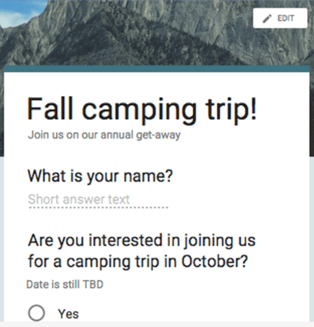
Underlying method
Machine Learning and Data Analysis
Database
(firebase)
Dynamic Ads

Slide 3
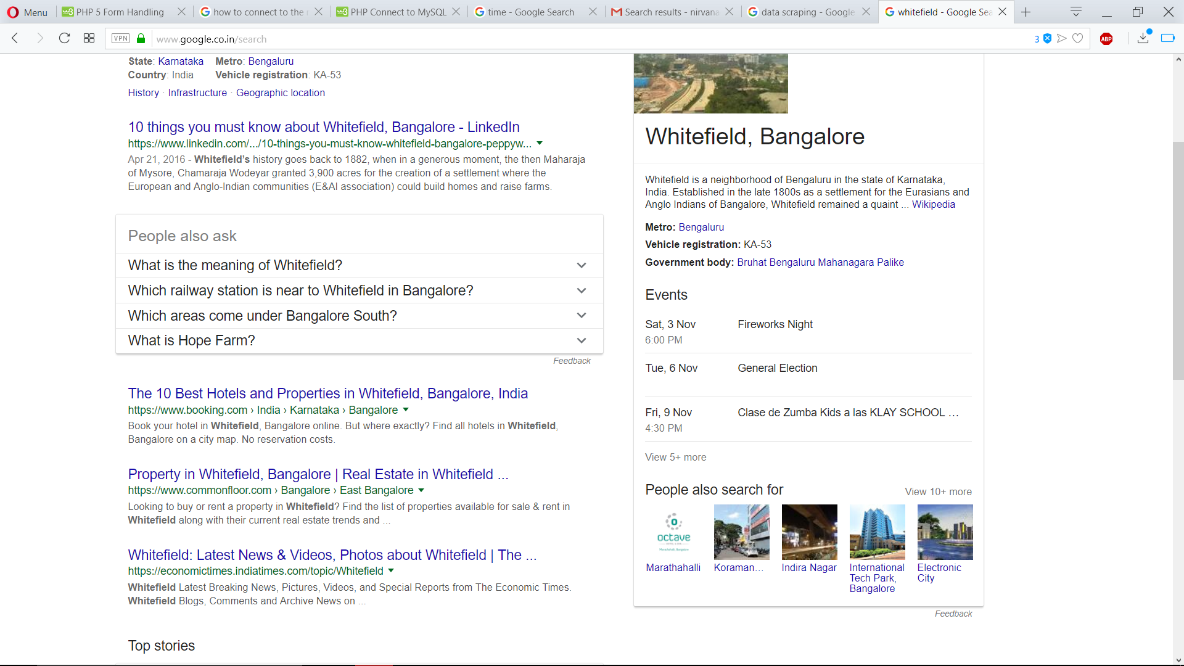
How do we get our data ?
Data scrapping
We can collect data for the humans biggest resource – the WWW
Property
Hotels
Property

Slide 4

Why ML and data analysis ?
To auto relate data
If ‘W’ and temp:30 cold drink =‘y’
If ‘S’ and temp:30 cold drink =‘n’
Here we certain rules certain pertaining to when a person drinks cold drink.
Decision tree : The one way out
season | temp | cold drink
w | 30 | y
s | 30 | y
w | 20 | n
s | 30 | y
w | 23 | n
w | 20 | n

Slide 5
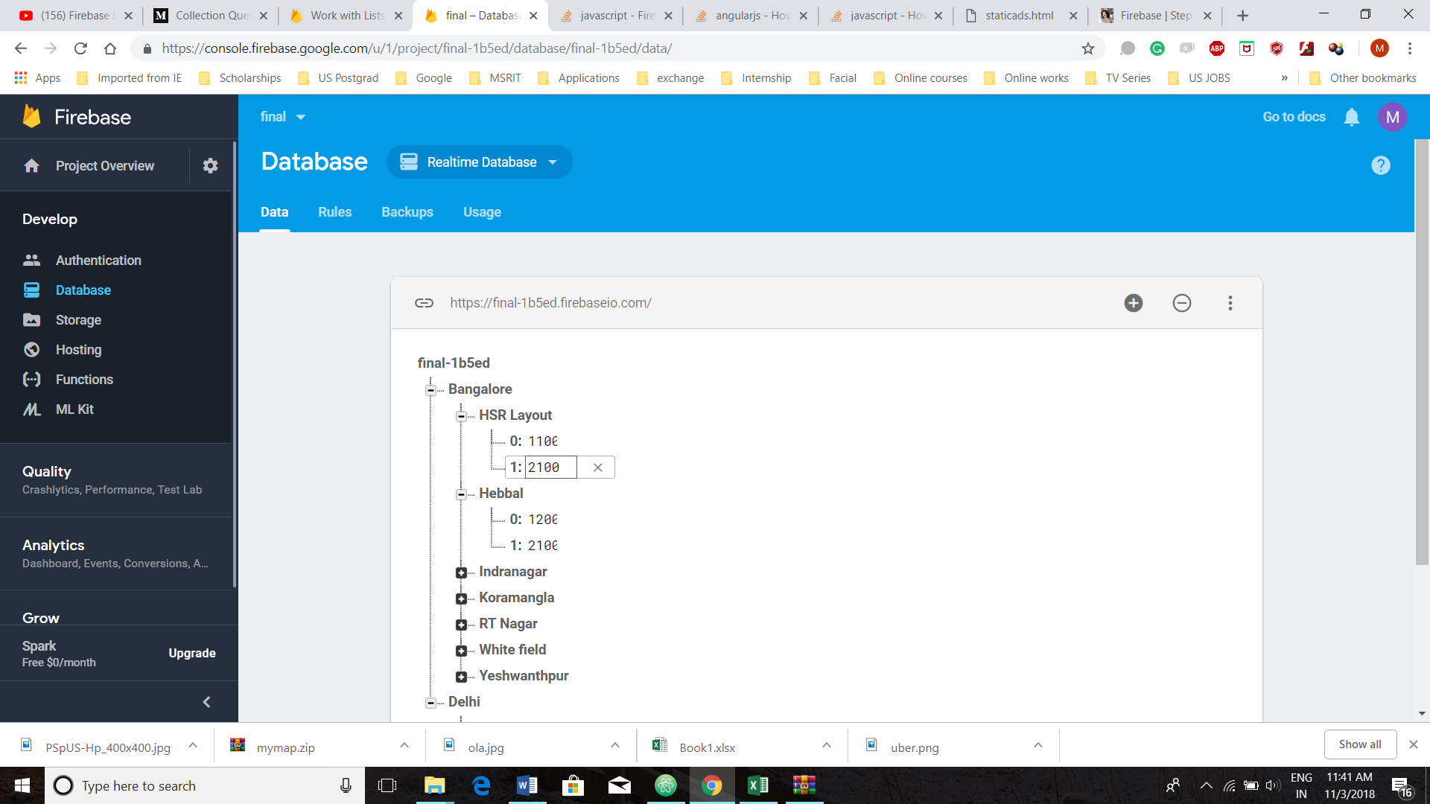
Firebase(database)

Slide 6
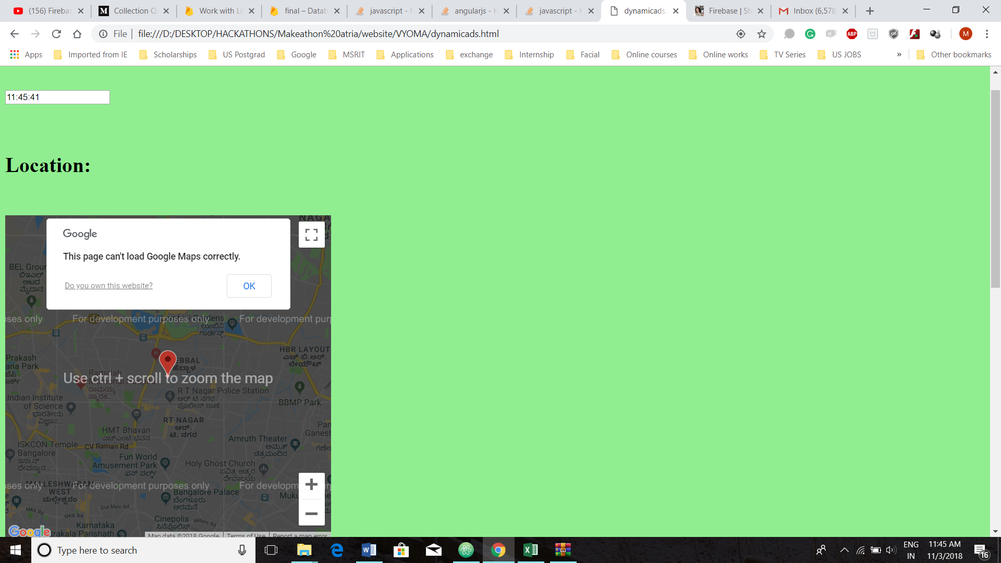

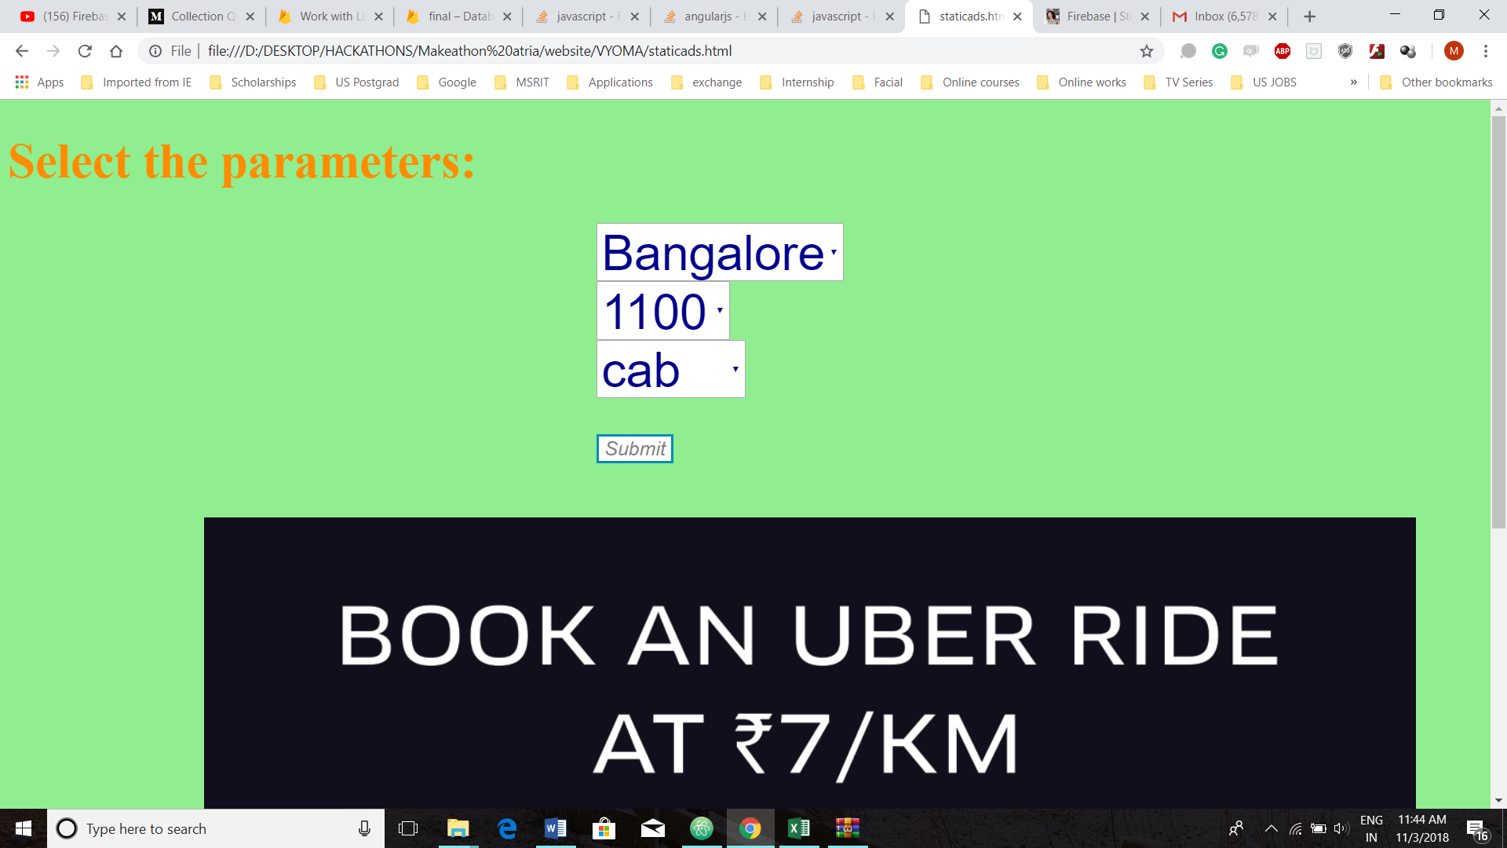
What matters?
ML Thanks your help !!

Slide 7
Time specific
Current location

Slide 8
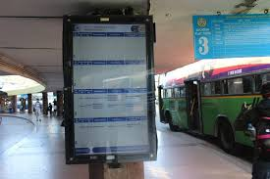
Why do we do this ? EXAMPLE-BILLBOARD
WE plan on targeting those people going to a specific place in Airports
Time specific
Current location

Slide 9
AdSense

Slide 10
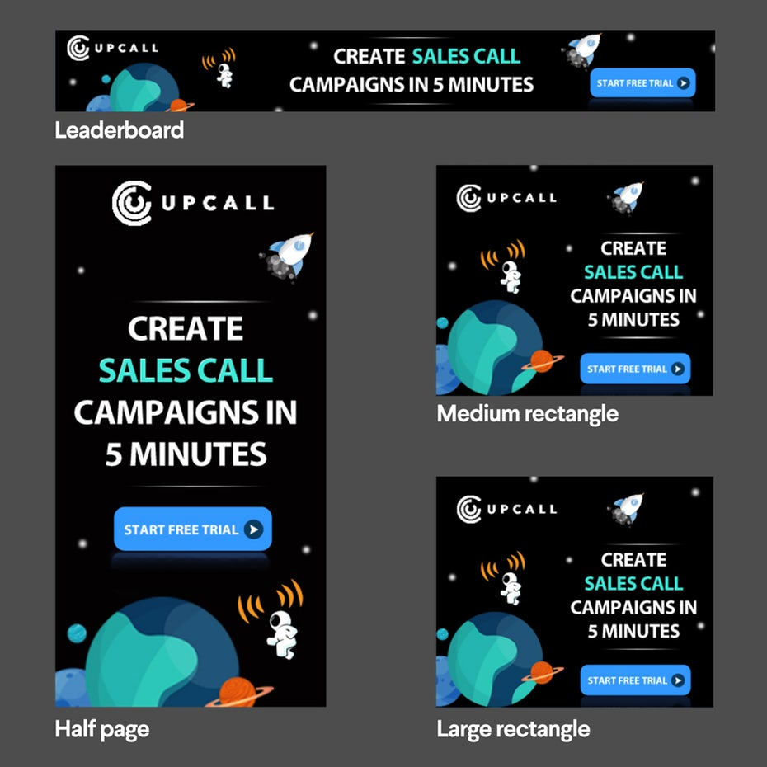


Keep it simple
Making it stand out
Positioning

